Slide 1


Grundfos
Market and
Wholesaler
e-Commerce Analysis

Slide 2






Joe Schaefer
Team 3
Caleb Kehrli
Cyclone Consulting
Lilly Creighton
Zachary Reaves
Introduction
Executive Analysis
Strategy
Financials
Conclusion

Slide 3



OBJECTIVE
KEY ISSUES
Provide Grundfos with recommendations to keep up with the rapid growth of e-commerce, while also maintaining competitive advantage though expansion.
Rapid-Paced e-Commerce Growth
Maintaining Customer and Wholesaler Relations
Introduction
Executive Analysis
Strategy
Financials
Conclusion

Slide 4
SOLUTIONS
IMPACT
1
Pursue 3P Relationship with Amazon
3% Increase Revenue YoY
2
Maintaining Continuity with our Historic partners
Create Contracts with Wholesalers
3
5% YoY increase in India Sales by Year 3
Target Indian Market
4
Implement Tech Support Chatbot
20% Decrease Operational Costs
Introduction
Executive Analysis
Strategy
Financials
Conclusion

Slide 5



ASSUMPTIONS
Common Trends Among Pump Installers Apply Globally
Existence of Wholesaler Locations in Target Markets
India Sales Make Up 2% of Sales Revenue
Introduction
Executive Analysis
Strategy
Financials
Conclusion

Slide 6


Implement 3P Amazon Partnership
Increase Brand Awareness
Access to Customer Reviews
Continue to Use Wholesalers
Well-Functioning Platform
Introduction
Executive Analysis
Strategy
Financials
Conclusion

Slide 7



Wholesaler Contracts
Maintain Positive Relationships
Ensure Wholesaler Usage
Implement Contracts
Confirm Wholesaler Discounts
Introduction
Executive Analysis
Strategy
Financials
Conclusion

Slide 8



Tech Support: Chatbot
24/7 Service
Live Support
Location Based
FAQ's & Video links
Handover to live agent
Refer to installer
Introduction
Executive Analysis
Strategy
Financials
Conclusion

Slide 9

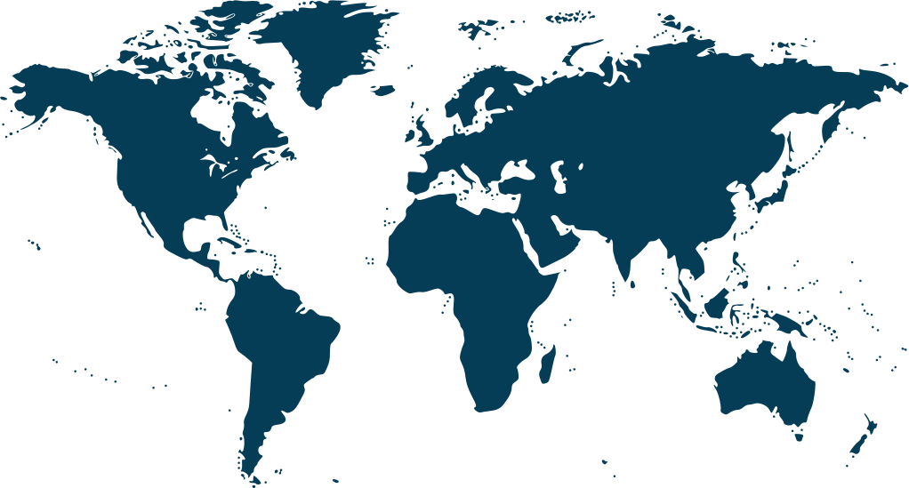


Increase Digital Marketing in India
GROWING PUMP MARKET
COMPETITIVE ADVANTAGE
3% YEARLY INCREASE IN INDIA SALES
Introduction
Executive Analysis
Strategy
Financials
Conclusion

Slide 10
IMPLEMENTATION TIMELINE
Year 1
Year 2
Year 3
Year 4
Year 5
Establish Amazon Agreement and 3-Year Wholesaler Contract
Re-Evaluate 3P Partnership
Re-Negotiate Wholesaler Contract
Make Necessary Updates
Amazon & Contract
Customer Reviews
Installer Outreach and Advertising
Continued Installer Outreach and Advertising
Decrease Digital Advertising
Market Expansion
Hire Marketing Manager for India Region
Decrease Outreach
Development
and
Implementation
Customer Evaluation
Software
Update
Customer Evaluation
Chat Bot
Patching
Introduction
Executive Analysis
Strategy
Financials
Conclusion

Slide 11

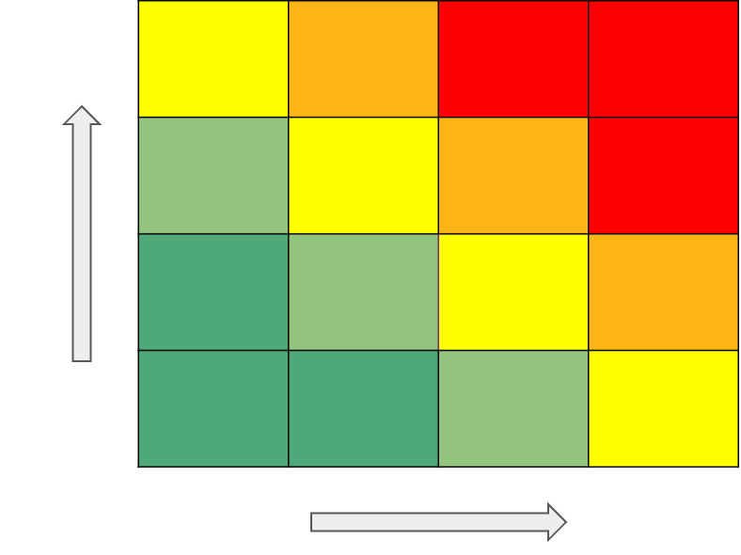
RISKS
1
Risking Relationships with Wholesalers
Contracts will ensure the wholesaler relationships stays in place.
2
Chat Bot Technical Issues
There will be regular maintenance and updates to the bot.
3
Infrastructure in India
Indian government is prioritizing infrastructure improvement.
Introduction
Executive Analysis
Strategy
Financials
Conclusion

Slide 12
RISK MITIGATIONS
1
Risking Relationships with Wholesalers
Contracts will ensure the wholesaler relationships stays in place.
2
Chat Bot Technical Issues
There will be regular maintenance and updates to the bot.
3
Infrastructure in India
Indian government is prioritizing infrastructure improvement.
Introduction
Executive Analysis
Strategy
Financials
Conclusion

Slide 13



KEY PERFORMANCE INDICATORS
Market Share in India
Sales Growth
Customer Reviews and Feedback
(CAC, LTV) (X-selling, Unit Sales) (CSAT, MTBR)
Introduction
Executive Analysis
Strategy
Financials
Conclusion

Slide 14
FINANCIAL ANALYSIS
ROI
Amazon 3P Partnership
8.2%
India Expansion
39.89%
Customer Service Chatbot
7.79%
Introduction
Executive Analysis
Strategy
Financials
Conclusion

Slide 15
Project Overview
3P
Amazon
Partner
Solutions
Wholesaler Contracts
India Marketing
Chatbot
3% Revenue Increase YoY
20% Decrease Operation Costs
5% YoY India Revenue Increase by Year 3
Impact
Improved Relationship
Introduction
Executive Analysis
Strategy
Financials
Conclusion

Slide 16
Appendix
Slide 1: 1/2/3 P Comparison
Slide 2: Current Presence in India
Slide 3: India Pump Market
Slide 4: Digital Market Trends
Slide 5: Chatbot Statistics
Slide 6: Grundfos and Amazon Timelines
Slide 7: Amazon Profit and Loss
Slide 8: Industries Disrupted by Amazon
Slide 9: Grundfos Profit and Loss
Slide 10: India Pump Market
Slide 11: Rupees to Dollars
Slide 12: Benefits to 3P Relationship
Slide 13: Disadvantages of 3P Relationship
Slide 14: Amazon Partnership and Contract Financials
Slide 15: India 5-Year Financials
Slide 16: India 10-Year Financials
Slide 17: India Market What-If
Slide 18: India ROI
Slide 19: Cost of Bot
Slide 20: Bot Impact
Slide 21: Bot, Contracts, and Amazon ROI

Slide 17
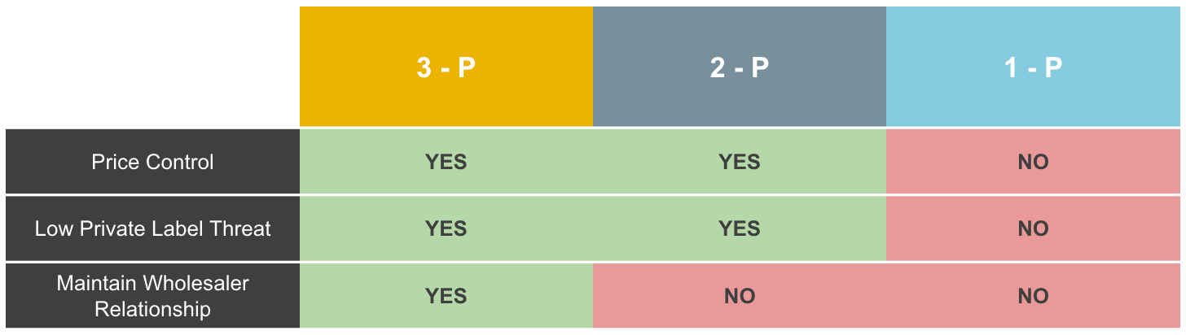

Amazon 1/2/3 P Comparisons

Slide 18
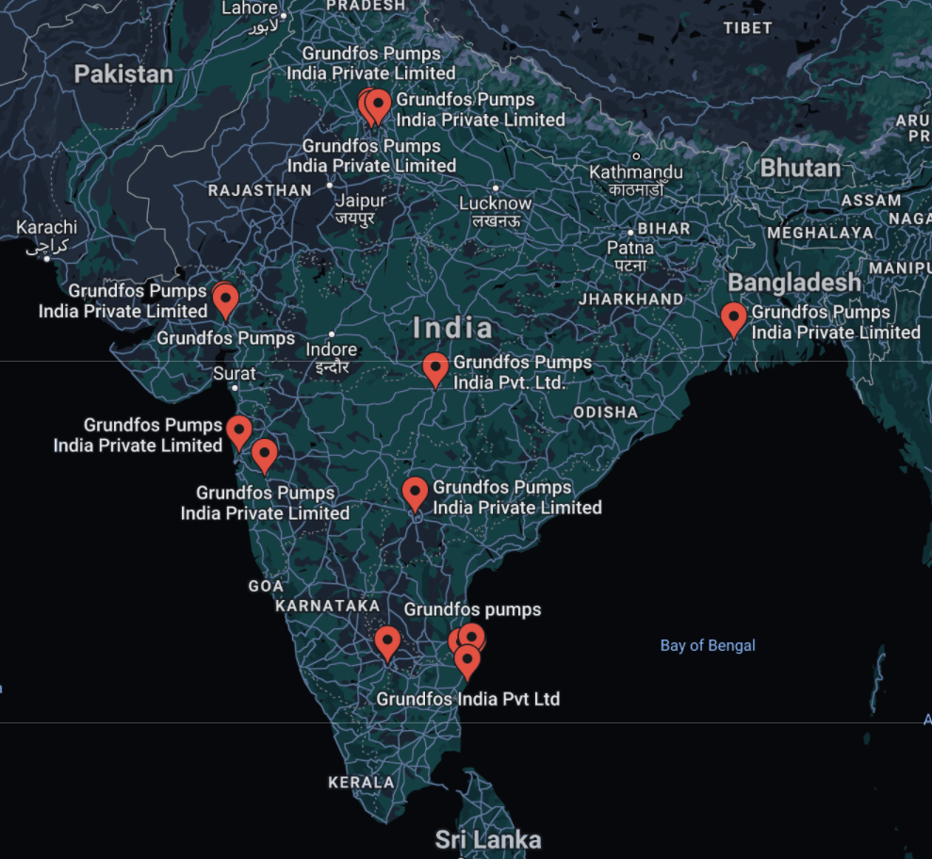
Current Presence in India
Source: Google Maps

Slide 19
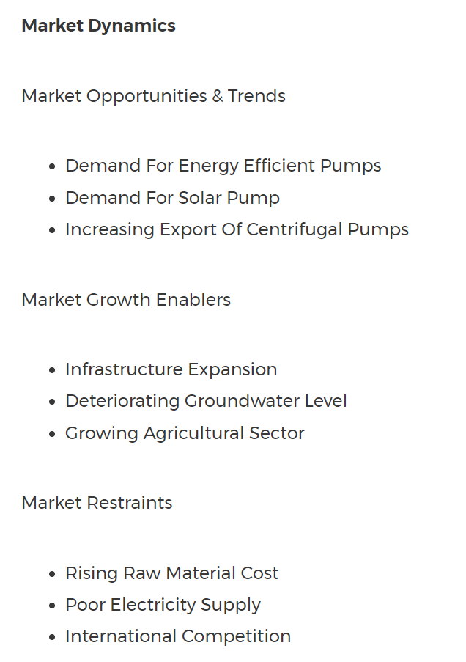
India Pump Market
https://www.businesswire.com/news/home/20201217005723/en/Pump-Market-in-India-2020-to-2026---Industry-Outlook-and-Forecast---ResearchAndMarkets.com

Slide 20
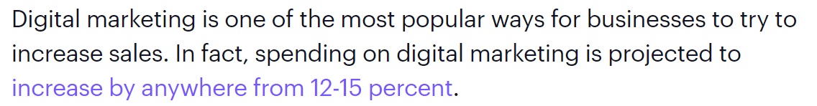
Digital Marketing Trends
https://books.google.com/books?hl=en&lr=&id=-1yGDwAAQBAJ&oi=fnd&pg=PT17&dq=digital+marketing&ots=XiSs8VnK23&sig=W3ue-57cJE1VtyDI7og2CtU6hTQ#v=onepage&q=digital%20marketing&f=false

Slide 21
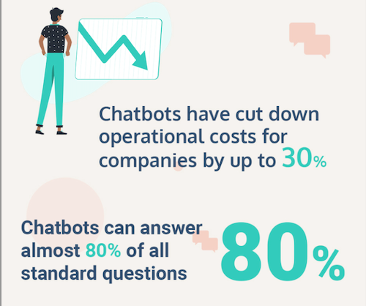
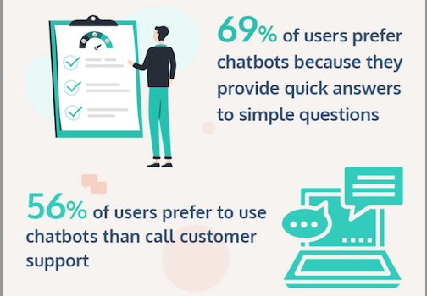
Chatbot Statistics

Slide 22
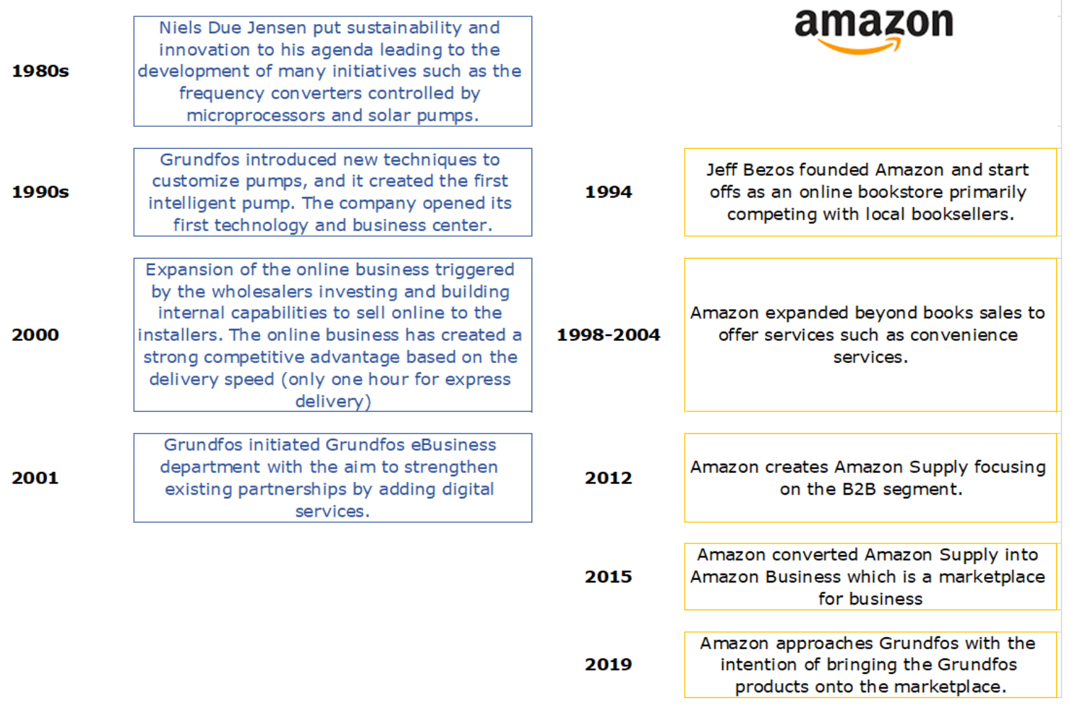
Grundfos and Amazon Timeline

Slide 23
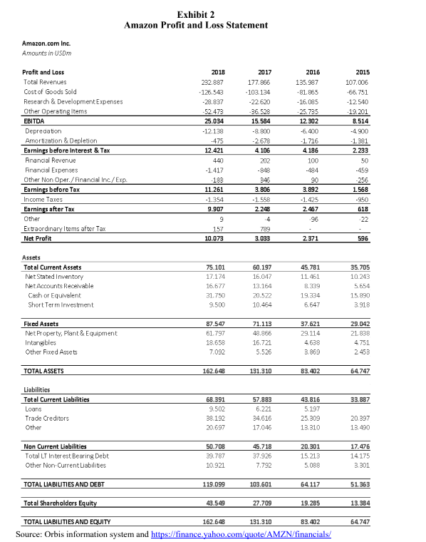

Slide 24
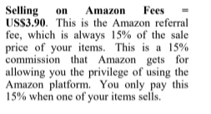
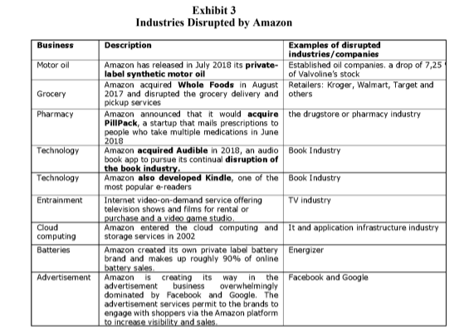
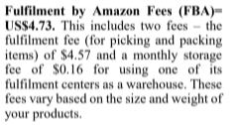
Industries Disrupted by Amazon

Slide 25
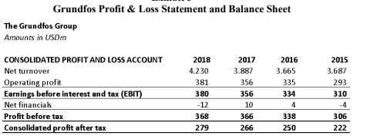
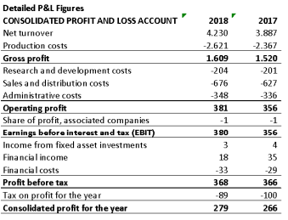
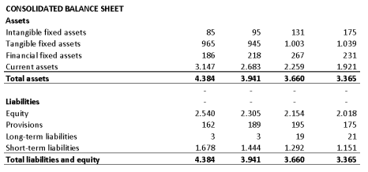
Grundfos Profit and Loss

Slide 26
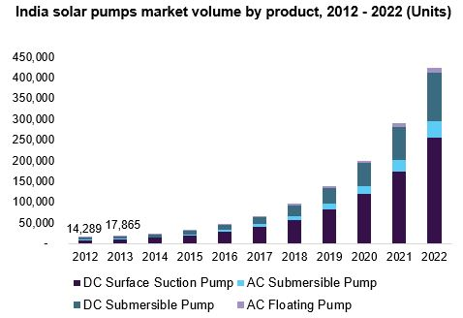
India Pump Market
https://www.grandviewresearch.com/industry-analysis/solar-pumps-market

Slide 27
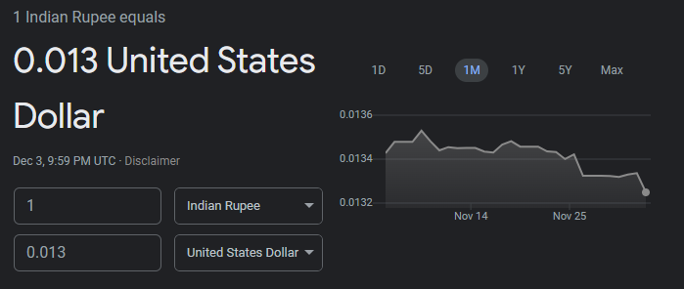
Rupees to Dollars
Source: Google Currency

Slide 28
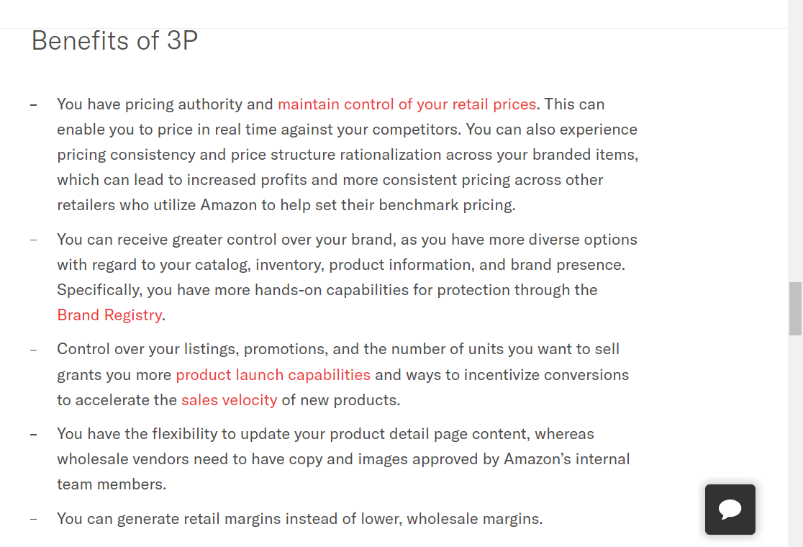
Benefits of 3P Relationship
https://feedvisor.com/university/amazon-1p-vs-3p/

Slide 29
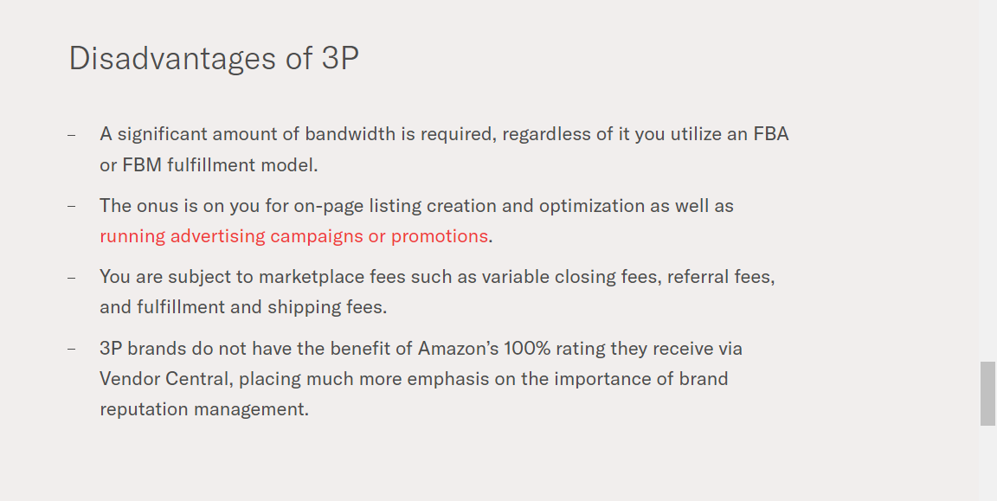
Disadvantages of 3P Relationship
https://feedvisor.com/university/amazon-1p-vs-3p/

Slide 30
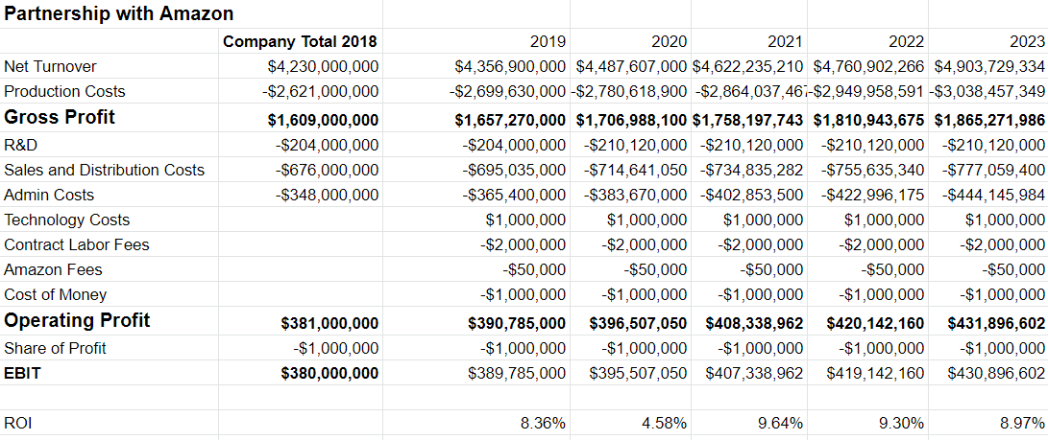
Amazon Partnership and Contracting Financials

Slide 31
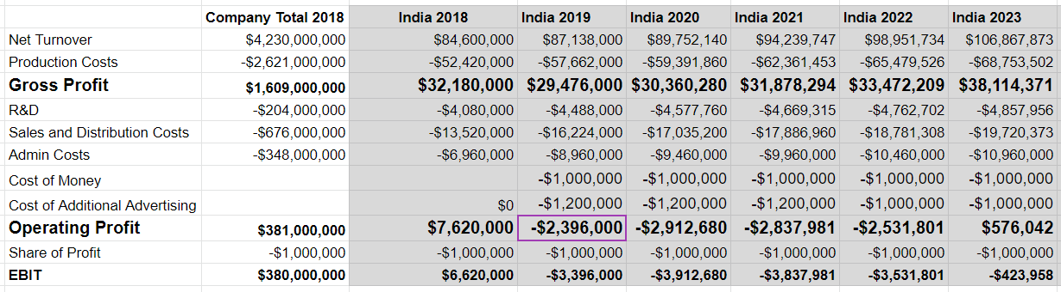
India 5-Year Financials

Slide 32
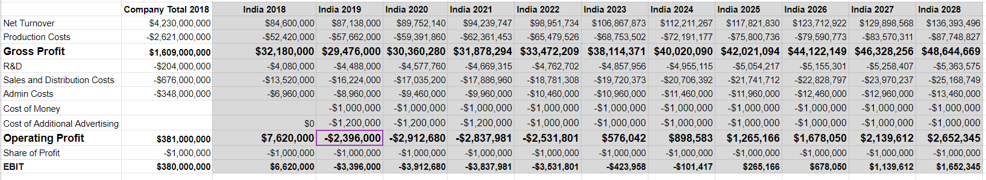
India 10-Year Financials

Slide 33
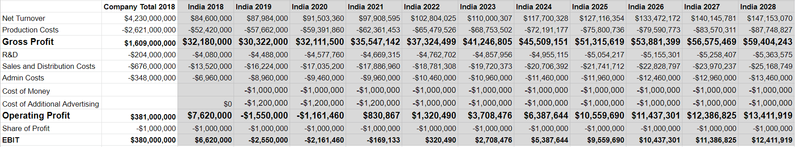
India Market What-If Analysis

Slide 34
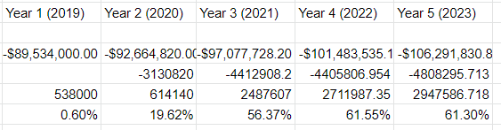
India ROI

Slide 35
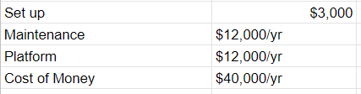
Cost of Bot

Slide 36
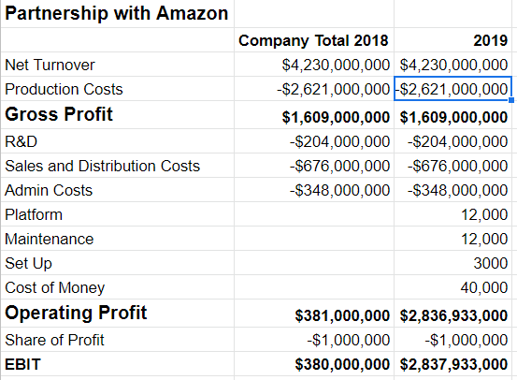
Bot Impact

Slide 37
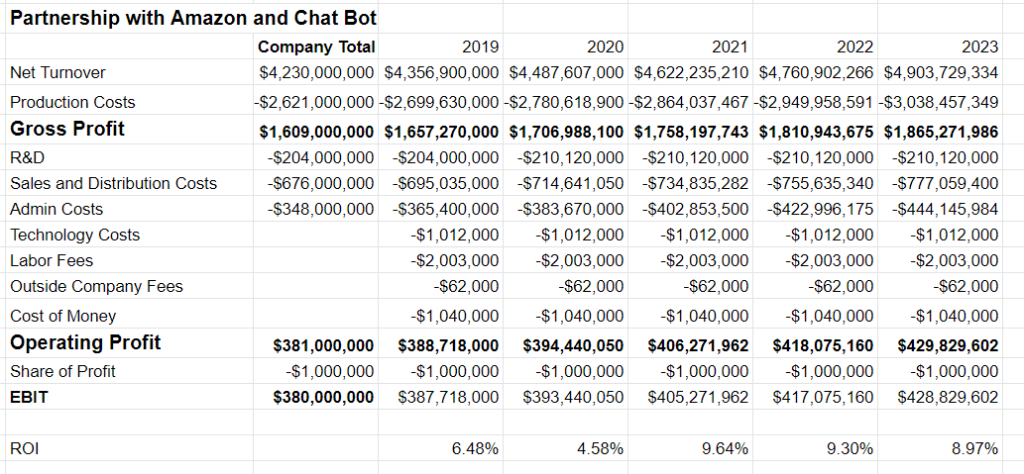
Bot, Contracts, Amazon ROI

